Slide 1
Goal: to determine the baseline in compliance with evidence-based guidelines for Bind members by race and ethnicity.
This will inform our 2022 OKR and identify targeted opportunities to improve care and access for our members.
Equity OKR 2021:
Establishing a baseline
Leo Zhou / Alex Lampert

Slide 2
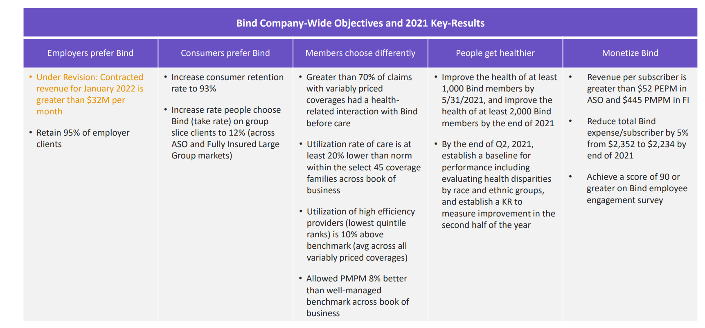
Bind OKRs

Slide 3
Background
One area of quality measurement focuses on evidence-based measures (EBM) standards. Milliman provides us with over 350 standards applied to claims data and as defined by NQF, HEDIS and other sources
A subset of these standards focus on the following – both types have cascading effects downstream
Overuse: services that represent aspects of waste or often unnecessary care
Underuse: services that are often vulnerable to lower levels of use even though best practice standards have been established
For every measure, we can calculate a “rate” which considers:
All members who met the criteria for a measure (for example, women over a specific age who have not had a bilateral mastectomy)
All members who had the targeted literature and clinically-based service (for example, screening mammograms)
We also include the University of Wisconsin Neighborhood Deprivation Index (NDI) in our models
Rankings of neighborhoods (census block groups) by socioeconomic disadvantage in a region of interest. Range 1 – 100 (least disadvantaged - most disadvantaged )
Finally, we use “predicted race” based on a number of data sources and models
Time frame: Jan 2019 – April 2021
Unit of observation: service-member combination
Notes:
Ebm: represent various delivery systems and care settings
Overuse ex:

Slide 4
Underuse summary index
Black
58%
White
61%
% of service-member pairs that should have gotten services and did
Hispanic
57%
Asian / PI
60%
More underuse
Less underuse

Slide 5
Underuse: Index components
% of service-member pairs that should have gotten services and didn’t (N) | White | Black | Hispanic
Comprehensive diabetes care: hemoglobin a1c (hba1c) testing | 82% (1157) | 81% (187) | 76% (138)
Chlamydia screening in women (total) | 34% (1437) | 53% (136) | 41% (116)
Colorectal cancer screening | 23% (674) | 35% (20) | 17% (48)
Prenatal and postpartum care: prenatal care | 33% (283) | 54% (28) | 48% (25)
Prenatal and postpartum care: postpartum care | 48% (283) | 54% (28) | 36% (25)
Percentage of members 18 years and older who met the PDC threshold of 80% for beta-blockers during the measurement period. | 67% (939) | 45% (112) | 61% (69)
Percentage of members 18 years and older who met the PDC threshold of 80% for renin angiotensin system antagonists during the measurement period. | 76% (2467) | 59% (306) | 63% (230)
Well-child visits in the third, fourth, fifth and sixth years of life | 70% (2239) | 56% (192) | 66% (231)
Note: for underuse measures, higher % = better

Slide 6
Overuse summary index
Black
28%
White
33%
% of service-member pairs that used services that were likely unnecessary
Hispanic
30%
Asian / PI
44%
Less overuse
More overuse

Slide 7
Overuse: Index components
Overuse EBM | White | Black | Hispanic
Use of antibiotic treatment for acute bronchitis/bronchiolitis (total) | 45% (206) | 31% (16) | 58% (26)
Inappropriate testing for pharyngitis (total) | 27% (599) | 55% (33) | 48% (63)
Use of opioids at high dosage | 3% (307) | 0% (44) | 5% (21)
Cesarean delivery rate, uncomplicated (overall) | 27% (599) | 35% (62) | 26% (53)
Use of imaging studies for low back pain | 77% (348) | 76% (41) | 61% (31)
NYU ED utilization algorithm: non-emergent | 17% (3370) | 23% (545) | 20% (490)
Use of opioids from multiple providers (multiple prescribers) | 15% (358) | 13% (53) | 13% (24)
Use of opioids from multiple providers (multiple pharmacies) | 4% (358) | 0% (53) | 0% (24)
Use of opioids from multiple providers (multiple prescribers and multiple pharmacies) | 2% (358) | 0% (53) | 0% (24)
Inappropriate treatment for upper respiratory infection | 11% (936) | 17% (70) | 19% (98)
Note: for overuse measures, lower % = better

Slide 8
National Deprivation Index - summary
Correlation | Age
NDI | 0.12
Predicted race/ethnicity | Average NDI
White | 37
Hispanic | 46
Black | 61
AIAN | 57
Weak positive correlation
Gender | Average NDI
Male | 37
Female | 41

Slide 9
Equity analytics
Driving research questions:
Are there differences in service use between races/ethnicities after controlling for age, gender, and socioeconomic status?
Is socioeconomic status predictive of receiving overuse or underuse services?

Slide 10
Summary of multivariate equity analytics
Significant predictors | Underuse Odds Ratio | Overuse Odds Ratio
Predicted race/ethnicity: Black | 0.74 | NS
Predicted race/ethnicity: Hispanic | 0.78 | 0.63
Gender: male | 0.9985 | 1.24
Age | 1.03 | 0.97
National Deprivation Index (NDI) | 0.997 | 0.99
Key takeaways, controlling for other factors | Our members who are predicted as Black or Hispanic are less likely to receive necessary (underuse) services comparing to White members | Our members who are predicted as Hispanic are less likely to use services that were unnecessary or tend to be overused comparing to White members

Slide 11
Now what?
Results support a focus on evidence-based medicine gap closure, particularly for underuse measures, for Blacks and Hispanics
The intention of the OKR is to track progress over time within race and ethnicity groups
For 2022, Bind will set targets for each population and then will develop strategies that target the specific measures driving the index for all of our members
Example: Since this analysis that race/ethnicity is a significant predictor of underuse and also that there are significant opportunities to increase the use of beta agonists in our membership, particularly among Blacks and Hispanics

Slide 12
Tables for EBM by race
- Aggregated measures
- Overuse measures
- Underuse measures
EBM analysis
- Exploratory data analysis (EDA)
- Methods
- Results
Analytic challenges
Analytic next steps
Bibliography
Equity OKR 2021:
Appendix

Slide 13
Index measures details
 | White | Black | Hispanic | Asian / Pacific Islander
% of service-member pairs that used services that were likely unnecessary | 33% (7478) | 28% (979) | 30% (862) | 44% (304)
% of service-member pairs that should have gotten services and didn’t | 39% (9957) | 42% (1028) | 43% (921) | 40% (542)
Note:
For overuse measures, lower % = better
For underuse measures, lower % = better
% = sum numerator / sum denominator
(sum denominator)
Notes:
Highlight takeaway: no signs of obvious inequality currently testing for statistical significance

Slide 14
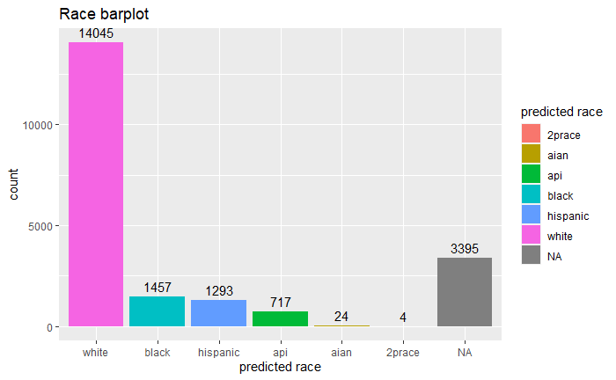
Predicted race – service/member pairs
Notes:
race NA: members were not active when the race prediction algorithms run 4/6/2021

Slide 15
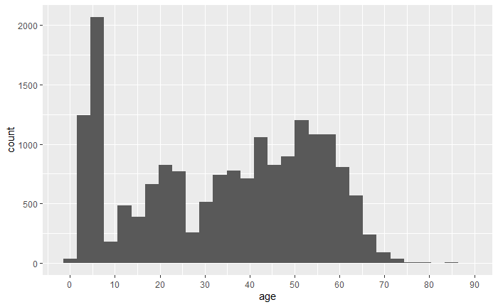
Age – service/member pairs
Notes:
Do not take too long here

Slide 16
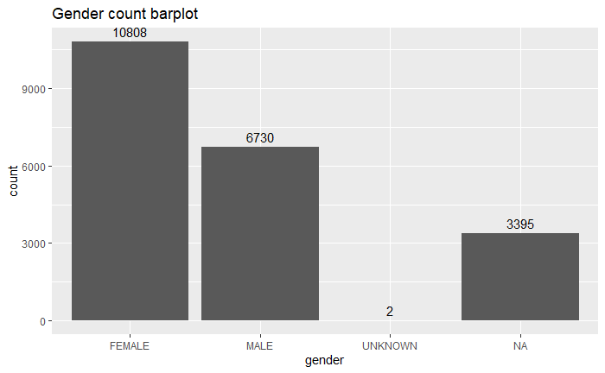
Gender – service/member pairs

Slide 17
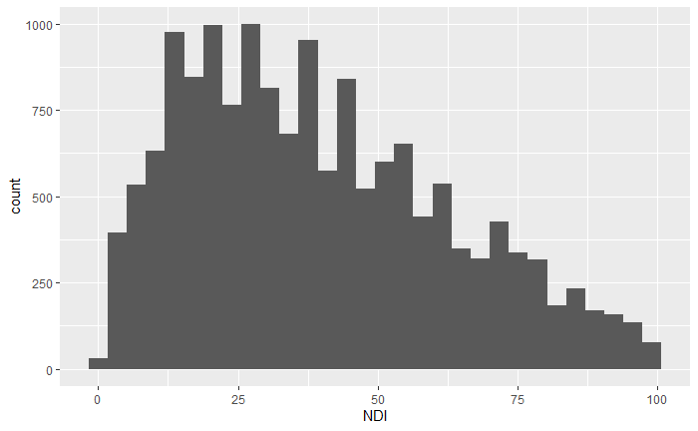
National Deprivation Index – service/member pairs
Least disadvantaged
Most disadvantaged

Slide 18
EBM analysis – Methods
Data table: for illustration purpose only
Member number | EBM label | Numerator
12345 | Use of Opioids at High Dosage | 0
12345 | Use of Imaging Studies for Low Back Pain | 0
09876 | Use of Imaging Studies for Low Back Pain | 1
Model Choice: Generalized Linear Mixed-Effects Model (glmer) with binomial response

Slide 19
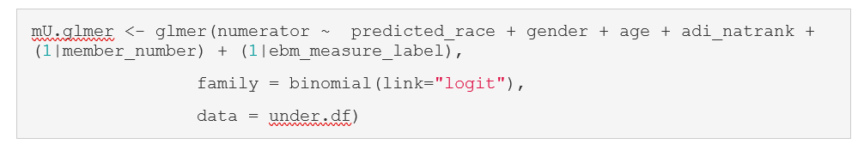
EBM analysis – Results
Underuse EBM
Variable | Estimated Coefficient | P-value
Intercept | -0.97 | 0.005
Predicted race/ethnicity: 2prace | -14.18 | 0.587
Predicted race/ethnicity: AIAN | -0.27 | 0.712
Predicted race/ethnicity: API | -0.05 | 0.635
Predicted race/ethnicity: Black | -0.3 | 0.000294***
Predicted race/ethnicity: Hispanic | -0.25 | 0.0046**
Gender: male | -0.0014 | 0.977
Age | 0.028 | <2e-16***
NDI | -0.003186 | 0.002218**

Slide 20
EBM analysis – Results
Underuse EBM
Variable | Odds Ratio
Intercept | --
Predicted race/ethnicity: 2prace | 0.0000006
Predicted race/ethnicity: AIAN | 0.76
Predicted race/ethnicity: API | 0.95
Predicted race/ethnicity: Black*** | 0.74
Predicted race/ethnicity: Hispanic** | 0.78
Gender: male | 0.9985
Age*** | 1.03
NDI** | 0.997
Key takeaway: our members who are predicted as Black and Hispanic are less likely to receive necessary (underuse) services
Notes:
interpretation for gender, age, NDI less imporatnt. Control for these to understand effect of race better

Slide 21
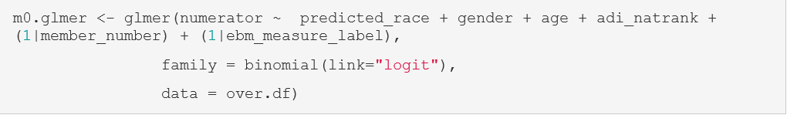
EBM analysis – Results
Overuse EBM
Variable | Estimated Coefficient | P-value
Intercept | 0.22 | 0.75
Predicted race/ethnicity: 2prace | -0.69 | 0.73
Predicted race/ethnicity: AIAN | 1.45 | 0.13
Predicted race/ethnicity: API | 0.04 | 0.85
Predicted race/ethnicity: Black | -0.12 | 0.49
Predicted race/ethnicity: Hispanic | -0.46 | 0.004**
Gender: male | 0.22 | 0.02957*
Age | -0.0296 | <2e-16***
NDI | -0.0046 | 0.01871*
Notes:
Take away

Slide 22
EBM analysis – Results
Overuse EBM
Variable | Odds Ratio
Intercept | --
Predicted race/ethnicity: 2prace | 0.50
Predicted race/ethnicity: AIAN | 4.2
Predicted race/ethnicity: API | 1.04
Predicted race/ethnicity: Black | 0.88
Predicted race/ethnicity: Hispanic** | 0.63
Gender: male* | 1.24
Age*** | 0.97
NDI* | 0.99
Key takeaway: our members who are predicted as Hispanic are less likely to receive overuse services

Slide 23
Challenges
EBM limited to those with sufficient sample size by race/ethnicity subgroups
Missing values: 16% of total rows do not have predicted race/ethnicity available
Limited peer reviewed literature on validation/goodness-of-fit for glmer logistic model

Slide 24
Summary
No obvious inequality of race/ethnicity at aggregate level
Potential inequality under specific measures
Members with predicted race/ethnicity Black and Hispanic are less likely to receive services when comparing to White
Socioeconomic status (NDI) appear to be a significant factor for receiving services

Slide 25
Next steps
Chi-square tests for each of the measures
Explore potential interaction effects
Goodness-of-fit test
Updated EBM methodology from Milliman

Slide 26
Bibliography
https://www.neighborhoodatlas.medicine.wisc.edu/
https://englianhu.files.wordpress.com/2016/01/faraway-extending-the-linear-model-with-r-e28093-2006.pdf
https://yury-zablotski.netlify.app/post/mixed-effects-models-4/#effects-soup-fixed-random-nested-crossed
https://cran.r-project.org/web/packages/ggeffects/vignettes/practical_logisticmixedmodel.html
https://stats.idre.ucla.edu/r/dae/logit-regression/

